Slide 1

Sentiment Analysis of Movie Reviews Using Deep Learning
Final Project Presentation

Slide 2
Introduction
Overview of Sentiment Analysis
Importance in Review Systems
Objective: To classify IMDB movie reviews into positive, negative, or neutral sentiments using deep learning models.
Notes:
Sentiment analysis is increasingly crucial in understanding how people feel about various products and services, particularly in the entertainment industry. Our project aims to classify sentiments of movie reviews from the IMDB database into positive, negative, or neutral categories using advanced deep learning techniques. This can help companies tailor their offerings and improve customer satisfaction.

Slide 3

Problem Statement
Challenges:
Complexity of human language (sarcasm, idioms, etc.)
Requirement to understand text context and semantic
Notes:
Dealing with human language in sentiment analysis presents unique challenges. Text often includes sarcasm, idiomatic expressions, and complex emotional states, all of which can complicate understanding and classification. Moreover, accurately capturing the context and semantics of phrases is essential for determining sentiment, which is what our models aim to achieve

Slide 4
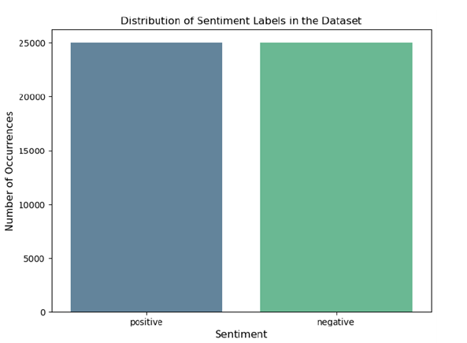
Data Description
Source: IMDB Database
Content: 50,000 movie reviews
Split: 25,000 training / 25,000 testing
Balance: Equal representation of positive and negative sentiments
Notes:
Our study utilizes a dataset from the IMDB database, consisting of 50,000 movie reviews, split evenly into training and testing sets. This balanced dataset ensures that our models learn to classify sentiments without bias toward more frequently occurring labels. Here's a visualization of our dataset distribution

Slide 5

Methodology
Algorithms Used: ANN, RNN, Transformer Models
Advantages of Each Model
Implementation: Python Libraries (TensorFlow, Keras)
Notes:
To address the complexities of sentiment analysis, we employed three types of neural networks: Artificial Neural Networks, Recurrent Neural Networks, and Transformers. Each model offers unique advantages in processing and interpreting the nuances of language, which are critical for accurate sentiment analysis.

Slide 6
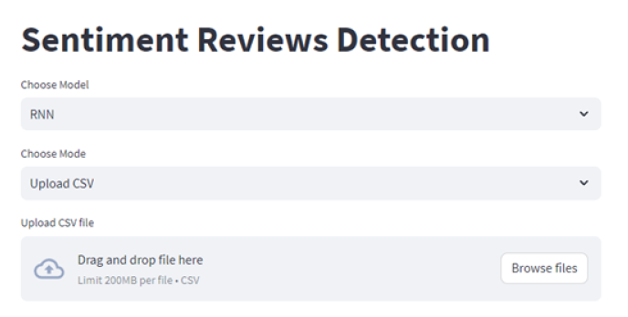
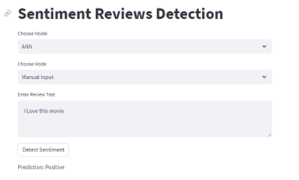
Front-End Interaction Tool
Description: Streamlit for creating web apps
Capabilities: Real-time sentiment analysis
User Interaction: Manual and CSV input modes
Notes:
To make our models accessible for real-world applications, we developed a web-based tool using Streamlit, which allows for real-time sentiment analysis. Users can input text manually or upload a CSV for bulk processing.

Slide 7
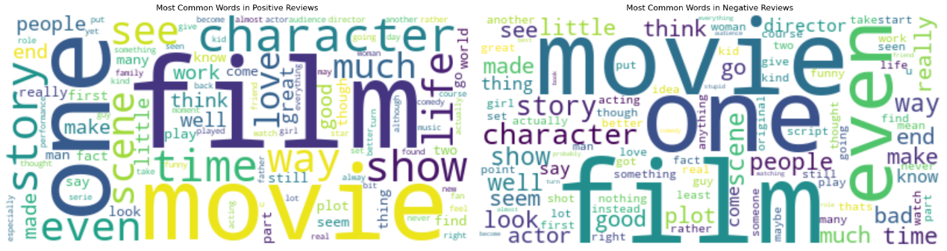
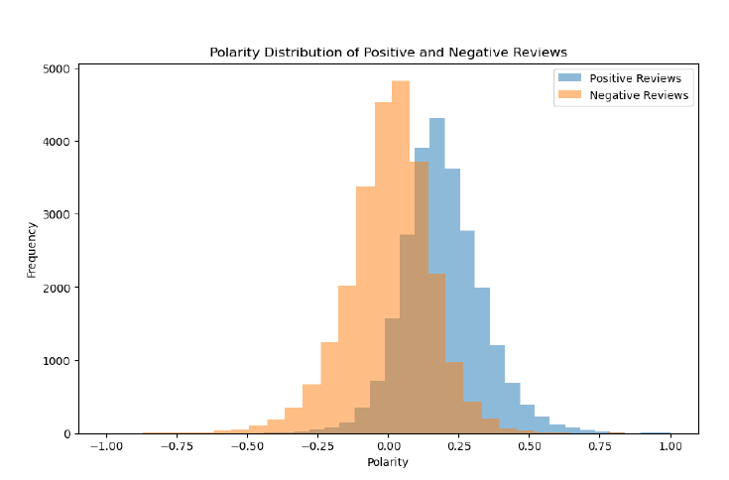
Preliminary Experiment Results
Word Cloud for Sentiment Analysis
Polarity Distribution
Notes:
Our initial findings were quite revealing. We began by examining the distribution of sentiments in our dataset and then used word clouds to visualize the most common words in positive and negative reviews.

Slide 8
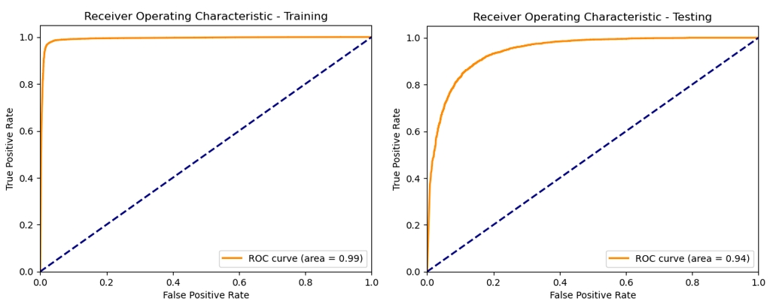
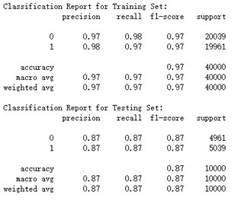
Model Evaluation
Metrics Used: Accuracy, Precision, Recall, F1 Score
Results Overview:
ANN Model Performance
RNN Model Insights
Transformer Model Capabilities
Notes:
Evaluating our models, we focused on accuracy, precision, recall, and the F1 score. Here are some of the key statistics from our evaluation. As you can see, each model performs well, with specific strengths and weaknesses

Slide 9
Conclusion and Future Work
Summary of Findings
Implications for Future Research
Enhancements: Addressing Overfitting, Model Transparency
Notes:
In conclusion, our models demonstrate a robust ability to classify sentiments in movie reviews effectively. Looking ahead, we plan to address challenges such as overfitting and improve the transparency of model decisions. This will enhance the utility of our tools in broader applications and ensure more reliable outputs in diverse scenarios.

